Slide 1



Netflix
View in Power BI
Last data refresh:
8/18/2024 8:51:17 AM UTC
Downloaded at:
8/18/2024 8:54:55 AM UTC

Slide 2
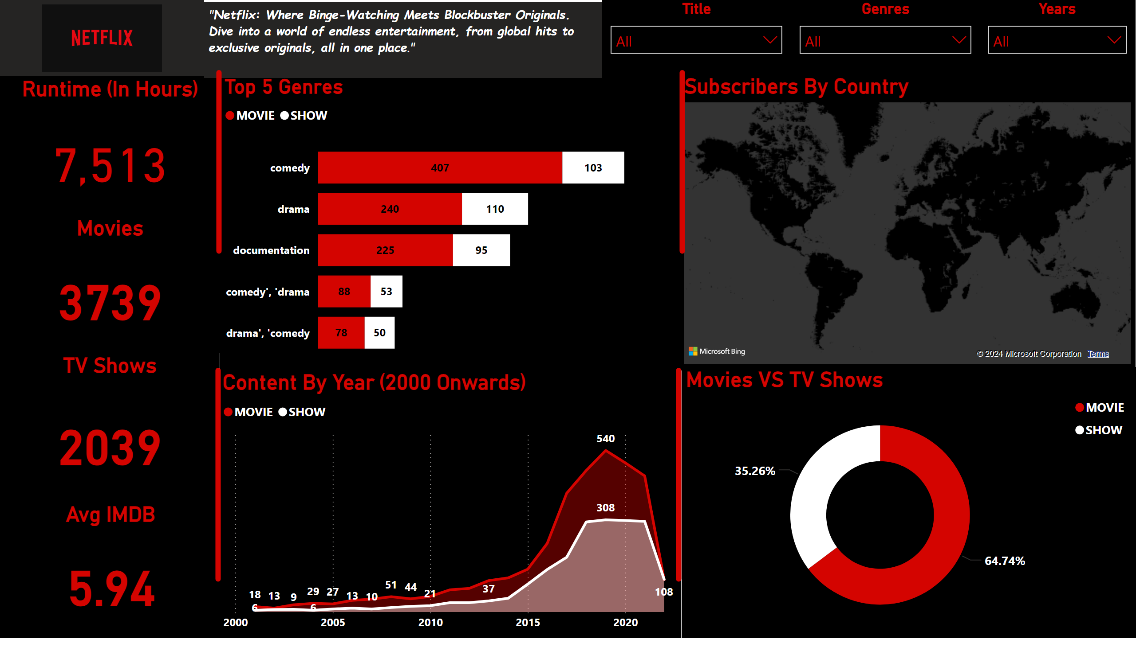
Page 1
Notes:
Top 5 Genres
No alt text provided
Content By Year (2000 Onwards)
No alt text provided
Movies VS TV Shows
No alt text provided
Subscribers By Country
No alt text provided
Runtime (In Hours)
No alt text provided
Avg IMDB
No alt text provided
Movies
No alt text provided
TV Shows
No alt text provided
Years
No alt text provided
Title
No alt text provided
Genres
No alt text provided
textbox
No alt text provided
image
No alt text provided
shape
No alt text provided
shape
No alt text provided
shape
No alt text provided
shape
No alt text provided

